Slide 1

无人机航拍场景下的语义三维重建
陈煜1701213988@pku.edu.cn
王尧 wangyao@pku.edu.cn
王旭普 806218468@qq.com

Slide 2
CONTENTS
PART 1
Introduction
PART 2
Semantic Segmentation
PART 3
Structure from Motion
PART 4
Results Display

Slide 3
Division & Cooperation
Name
Student ID
Work
陈煜
1701213988
稀疏点云模型生成
王尧
1701214012
语义分割
王旭普
1701214013
前端结果展示

Slide 4
Brief Introduction to 3D Reconstruction
Input
Raw pictures taken from different views
Output
Point Clouds (Sparse & Dense)
Depth Map
Mesh

Slide 5
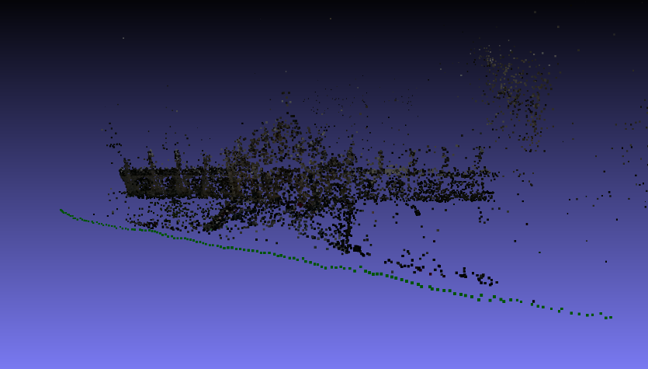
Motivation
Improve both efficiency and accuracy of reconstruction (semantic information)
Improve the accuracy of semantic segmentation (3D semantic points)
Automatic semantic segmentation
Notes:
三维重建中的点云去噪
在目前的科研场景中，公开标注数据最多，最为成熟的室外场景数据集主要包括两种：街景与卫星。
根据我们的调研，没有找到公开的带有像素级标注的无人机航拍数据集 (拍摄⾼度约在40-150米)。

Slide 6
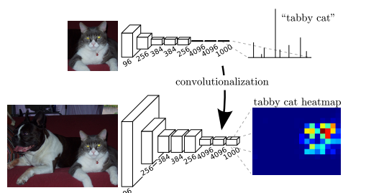
Semantic segmentation
FCN: Transforming fully connected layers into convolution layers
Notes:
将端到端的卷积网络推广到语义分割中；
重新将预训练好的Imagenet网络用于分割问题中；
使用反卷积层进行上采样；
提出了跳跃连接来改善上采样的粗糙程度。

Slide 7

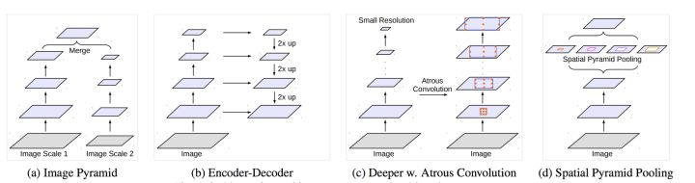
from FCN to Deeplab
Atrous convolution
FCN方案 | 问题 | deeplab解决方案
反卷积 | 特征图分辨率过低，空间位置信息丢失 | 膨胀卷积(Atrous convolution)
跳边结构，多尺度卷积层结果融合 | 小尺度物体无法识别， | 膨胀金字塔池化(Atrous spatial pyramid pooling )
Atrous spacial pyramid pooling
Notes:
需要注意的是，该模型预测分割图的大小是原图像大小的1/8。这是几乎所有方法中都存在的问题，将通过内插方法得到最终分割图。

Slide 8
Dataset Construction
Data selection
Semantic labeling
Post process
Enrich the variety from different:
Drone height
Light(shadow)
Camera angle
Image content
The labeling method is:
By photo shop
Semi-automatic
5 min per image
The main goals are:
To combine semantic masks into single ground truth label
To deal with multi-labeled/unlabeled pixel
Train_set | Validation _set
156 | 45

Slide 9
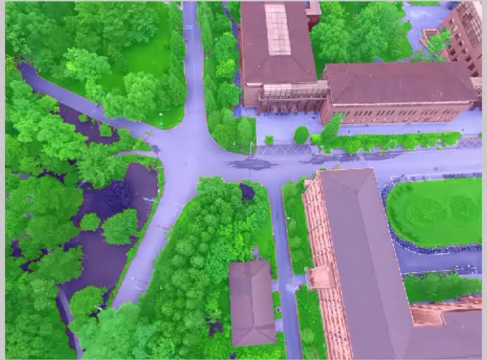
Dataset glimpse

Slide 10
Training
Hyper Parameters
Backbone network | ResNet-101 Imagenet pretrained model
Optimizer | Adam
Crop size | 513*513
Init Learning rate | 2.5e-4
Momentum | 0.99
batch size | 6
Weight decay | 2e-4
Max epoch | 10
Result
MIoU | 88.7
Mean accuracy | 94.1

Slide 11
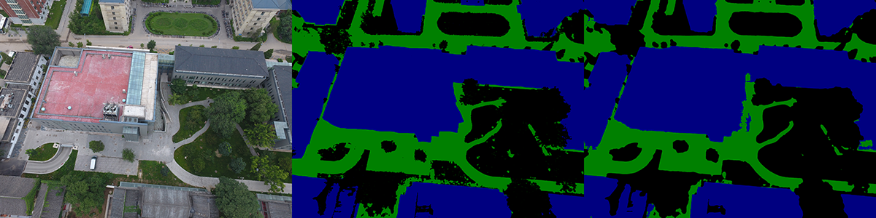
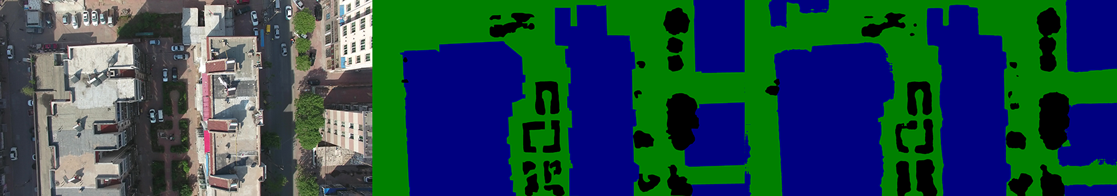
Result-validation
campus
huludao

Slide 12
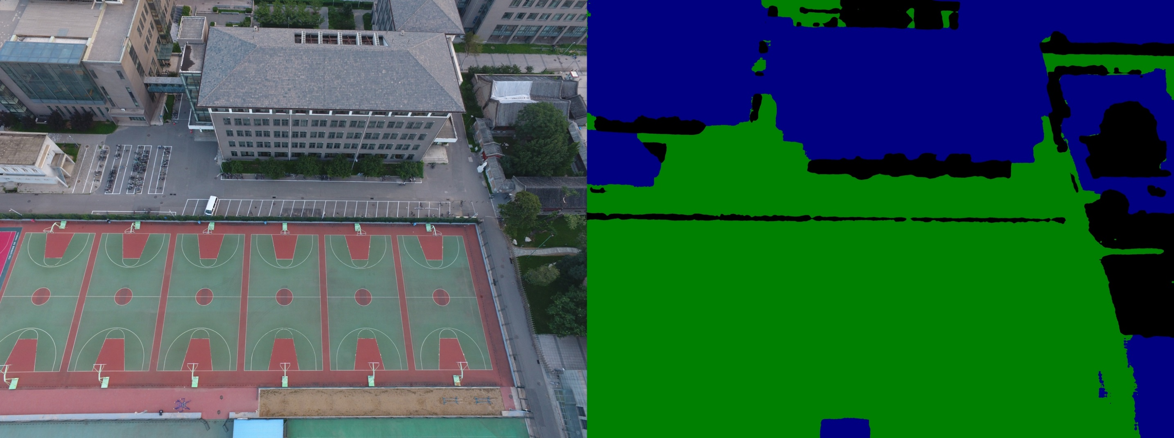
Result-test
campus

Slide 13
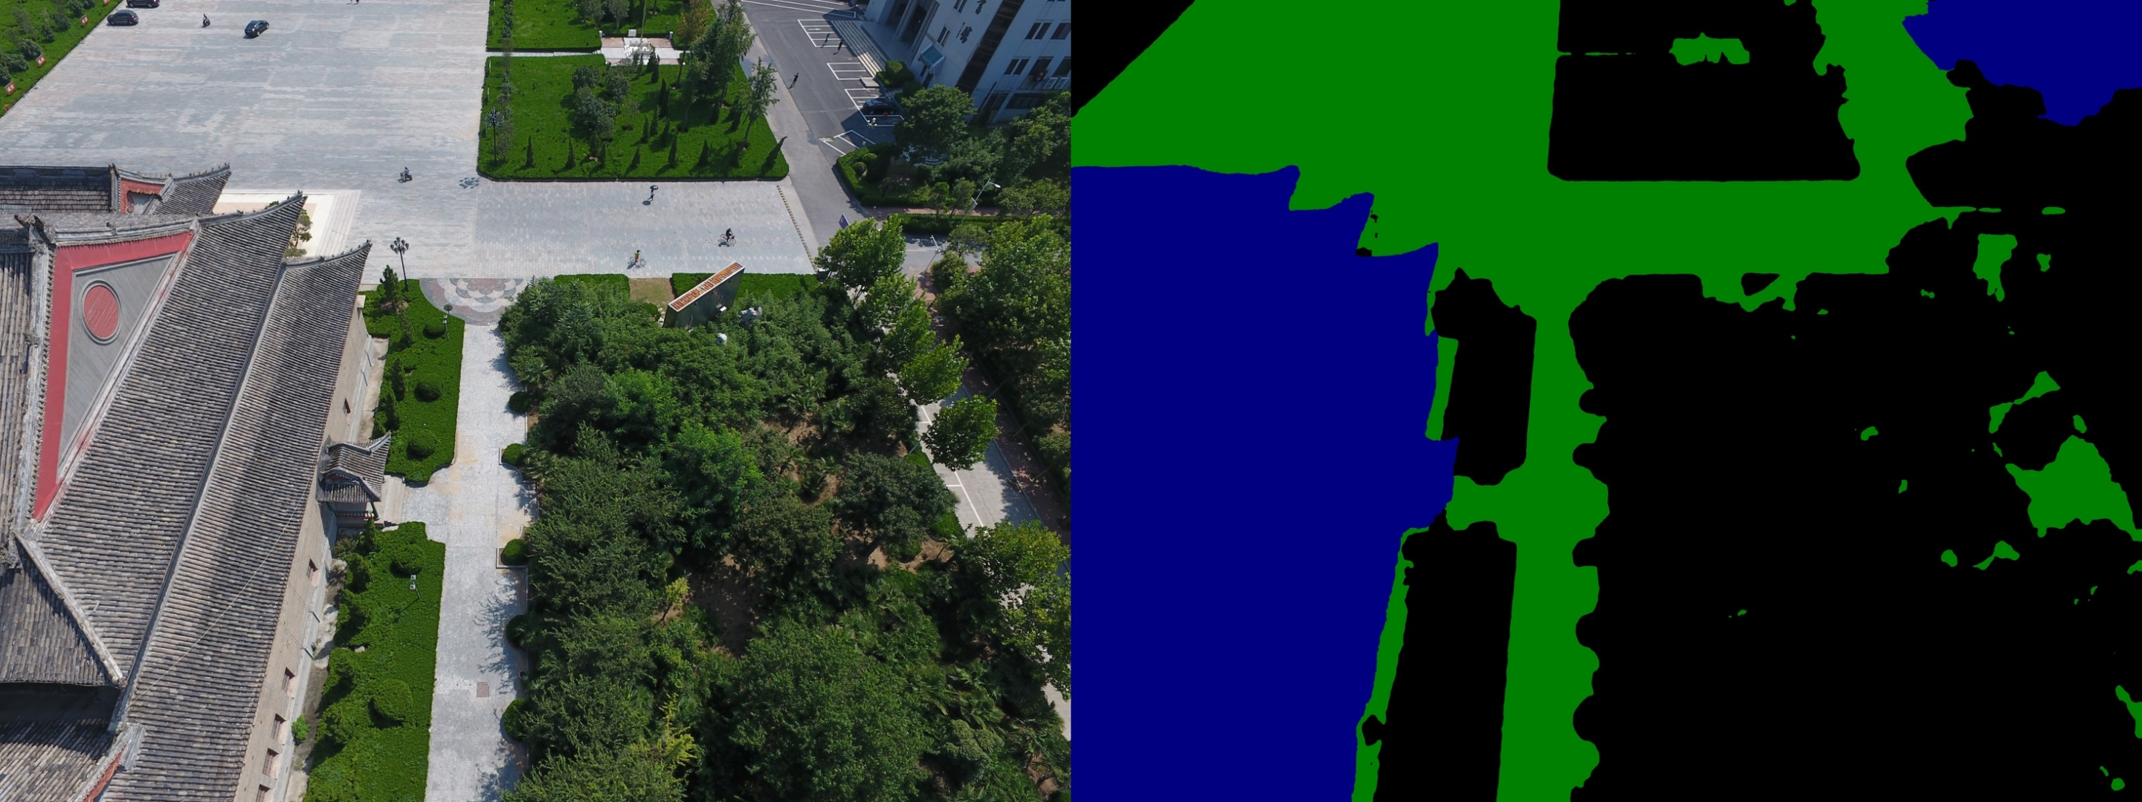
Result-test
Heda-dalitang

Slide 14
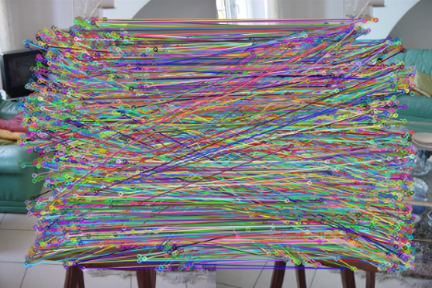
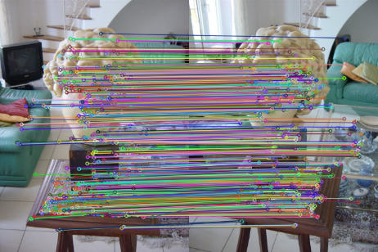
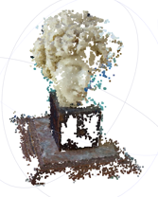
Pipeline for SfM
Pictures
Feature Matching
Geometric Verifying
Initial Pair Selection
Bundle Adjustment
Triangulation
Camera Registeration
sparse model

Slide 15
Semantic Feature Extracts
- SIFT keypoint detector
- Extract semantic label by semantic segmentation result
- Group features by semantic label, then perform feature matching

Slide 16
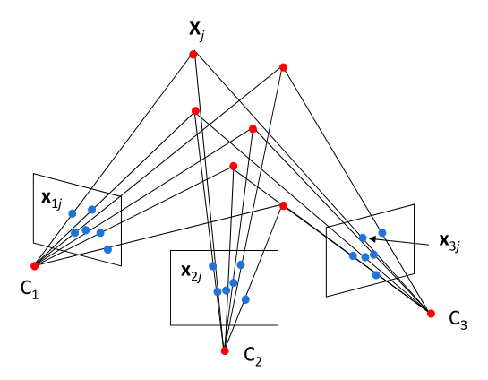
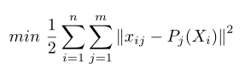
Bundle Adjustment
- Bundle Adjustment
- Solved by Levenburg-Marquart method

Slide 17
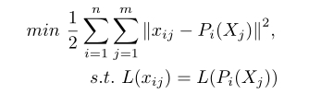
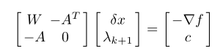
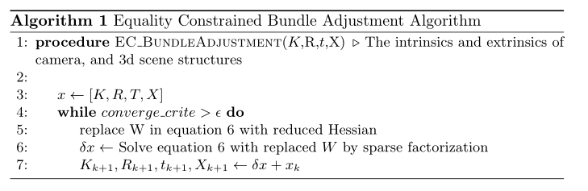
Constrained Bundle Adjustment
- Constrained Bundle Adjustment
- Solved by Sequential Quadratic Programming

Slide 18
Reconstruction Results
Dataset
Views
Original SfM
Semantic SfM
Poses
Points
Tracks
RMSE
Time
Poses
Points
Tracks
RMSE
Time
HU-hall
195
195
476,853
760,769
0.536045
2h 10m 39s
195
473,056
745,969
0.531877
2h 5m 39s
PKU-e33
392
392
559,065
810,390
0.565699
3h 28m 43s
392
554,449
803,395
0.561667
3h 21m 29s
PKU-e44
337
337
468,978
641,171
0.546114
5h 23m 10s
337
469,371
635,279
0.538501
3h 7m 13s
PKU-m1
288
288
422,158
650,072
0.564724
2h 32m 10s
288
420,044
644,405
0.560242
2h 30m 49s
Huludao-n15
248
244
484,229
667,029
0.529639
2h 40m 07s
248
484,915
647,101
0.520202
2h 37m 10s
Black: Normal/Unchanged Value Red: Exception Value Green: Increased Value Blue: Decreased Value

Slide 19
Result Display
使用nodejs搭建一个本地网站进行结果展示
Nodejs 较为轻量级，可以在localhost:3000运行
可以通过网页提交模型文件
使用网页展示结果，更加直观

Slide 20
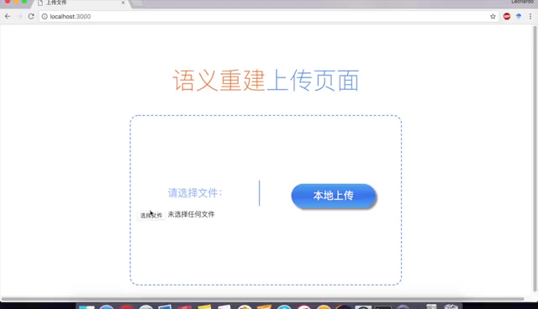
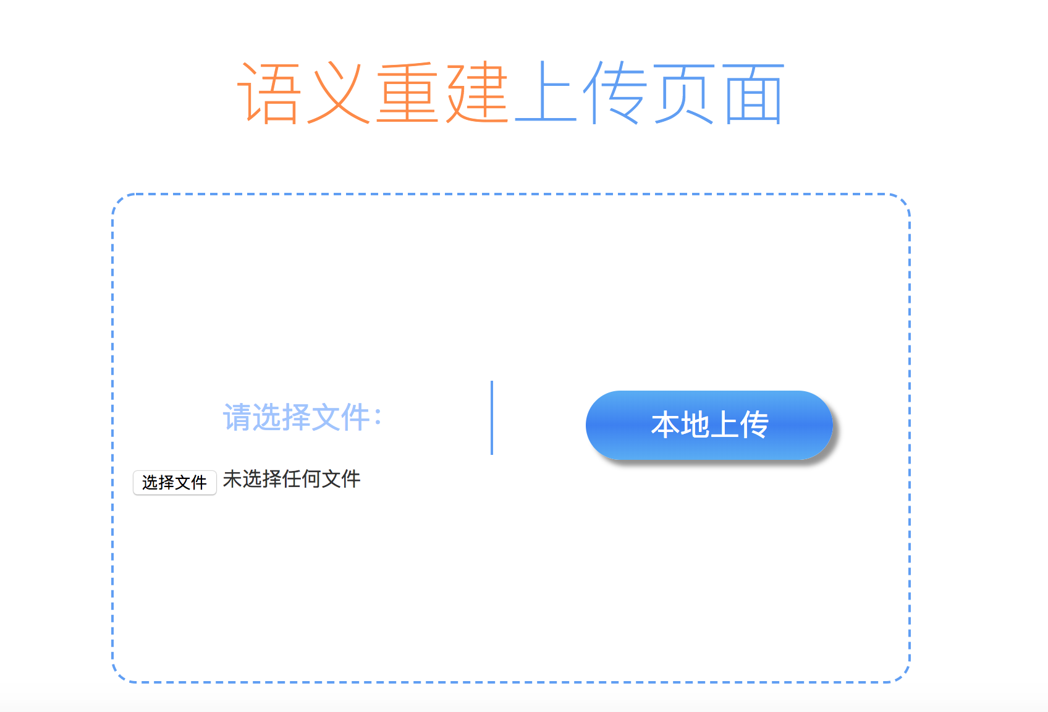
Model Upload

Slide 21
Model Render
使用WebGL来处理模型的导入
使用three.js来导入模型，读取模型的点位置
使用PointsMaterial来渲染模型的颜色
使用canvas在web页面展示模型
使用controller来添加模型控制，可以对模型进行旋转操作

Slide 22
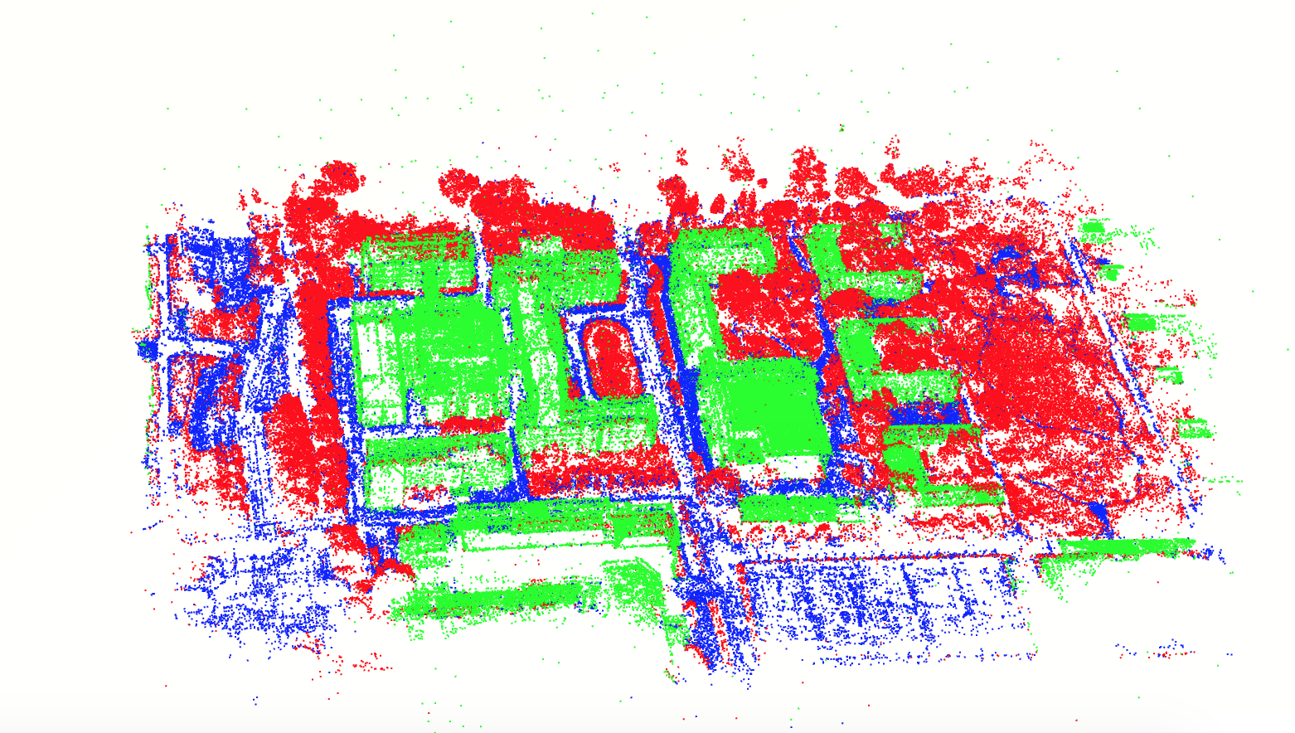
Model Display

Slide 23
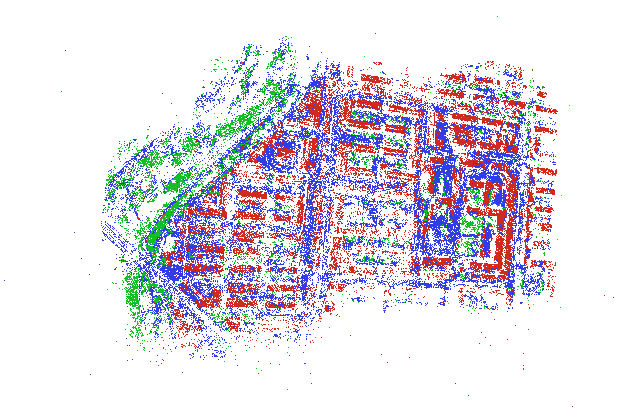
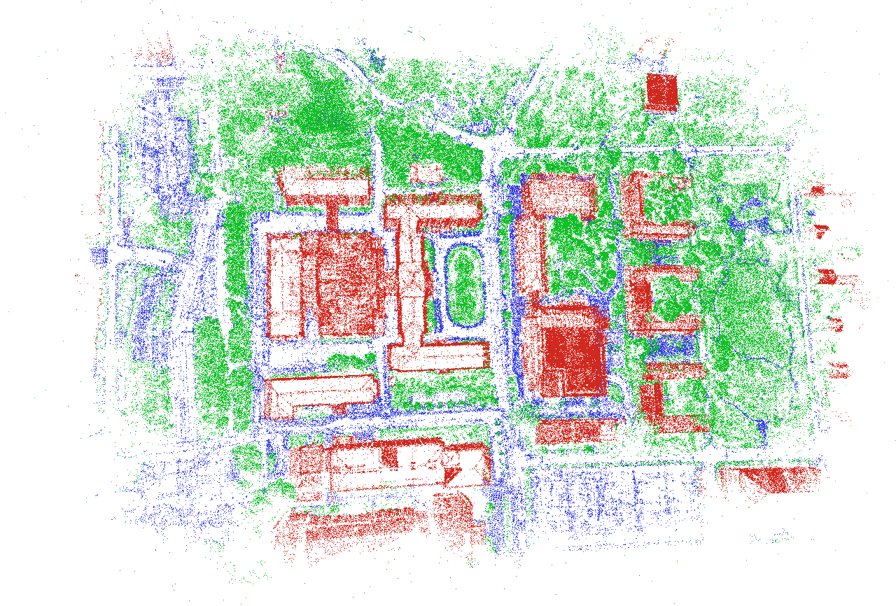
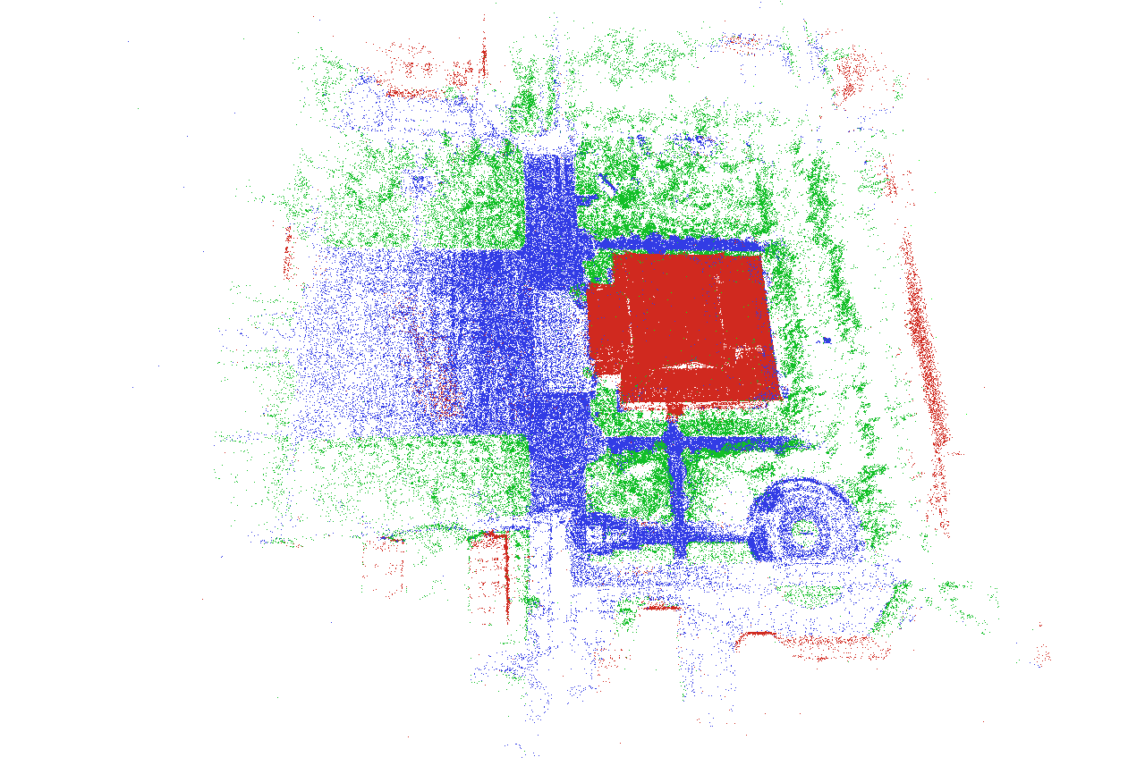
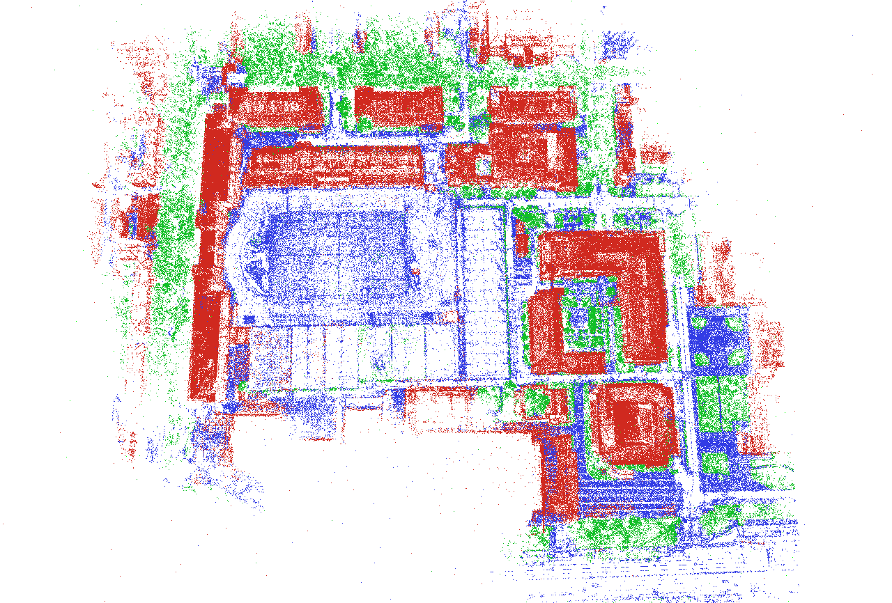
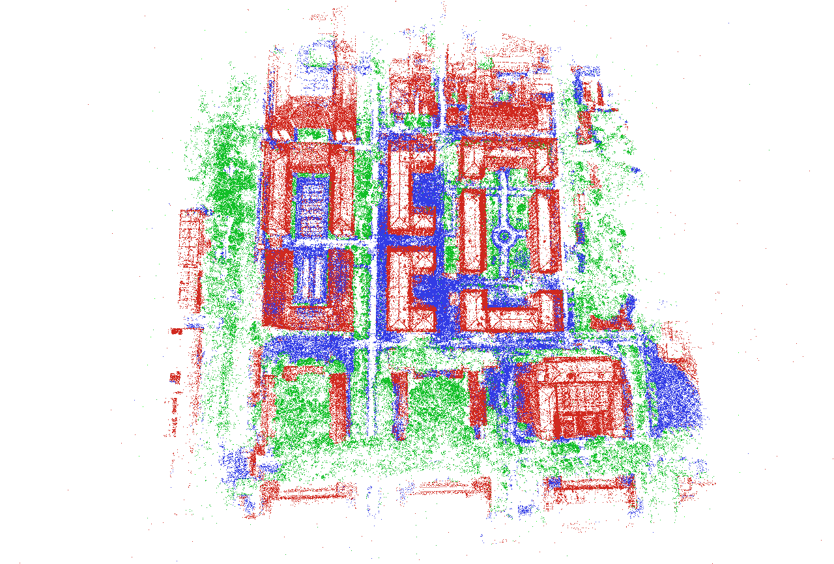
Model Display

Slide 24
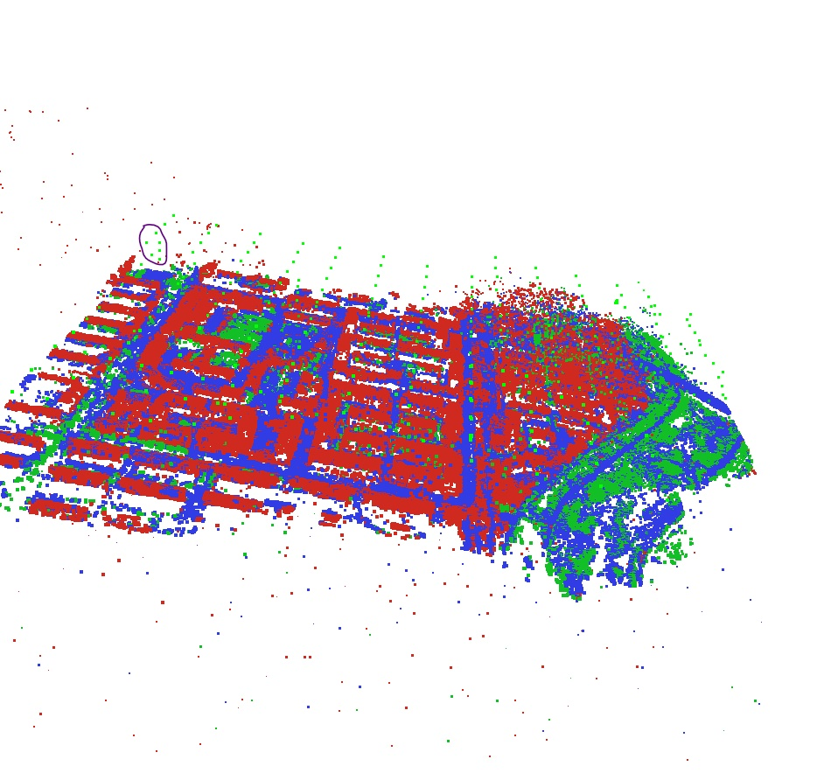
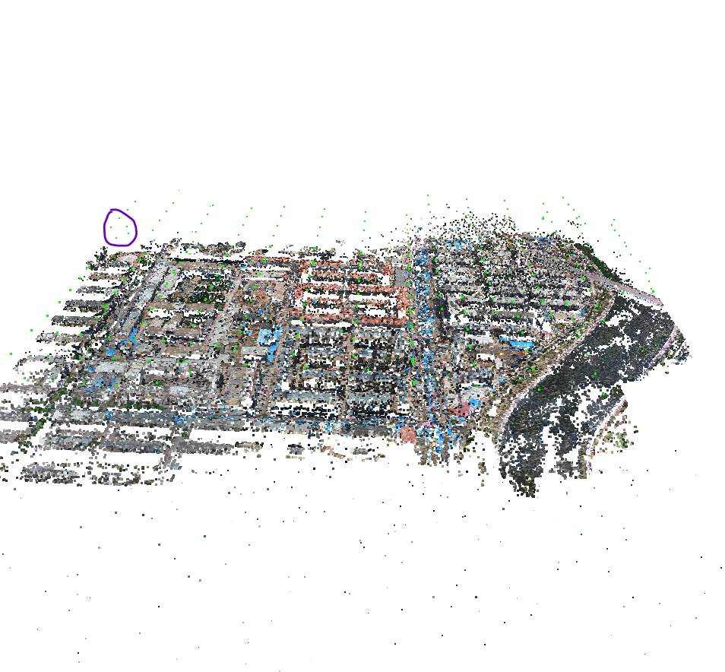
Model Display

Slide 25
Future Work
- Learning semantic features
- Dense reconstruction for automatic semantic segmentation

Slide 26
References
[1] Noah Snavely, Steven M. Seitz, Richard Szeliski. Photo Tourism: Exploring image collections in 3D. ACM Transactions on Graphics (Proceedings of SIGGRAPH 2006), 2006.
[2] Snavely K N. Scene reconstruction and visualization from internet photo collections[M]. University of Washington, 2008.
[3] Schönberger J L, Frahm J M. Structure-from-Motion Revisited[C]// Computer Vision and Pattern Recognition. IEEE, 2016.
[4] Wu C. Towards Linear-Time Incremental Structure from Motion[C]// International Conference on 3dtv-Conference. IEEE, 2013:127-134.
[5] Moulon P, Monasse P, Marlet R. Adaptive structure from motion with a contrario, model estimation[C]// Asian Conference on Computer Vision. Springer Berlin Heidelberg, 2012:257-270.
[6] Schönberger J L, Frahm J M. Structure-from-Motion Revisited[C]// Computer Vision and Pattern Recognition. IEEE, 2016.
[7] Sweeney C, Hollerer, Tobias, Turk M. Theia: A Fast and Scalable Structure-from-Motion Library[J]. 2015:693-696.
[8] Fischler M A, Bolles R C. Random sample consensus: a paradigm for model fitting with applications to image analysis and automated cartography[J]. Readings in Computer Vision, 1987, 24(6):726-740.
[9] Triggs B, Mclauchlan P F, Hartley R I, et al. Bundle Adjustment - A Modern Synthesis[C]// International Workshop on Vision Algorithms: Theory and Practice. Springer-Verlag, 1999:298-372.
[10] Wilson K, Snavely N. Robust Global Translations with 1DSfM[C]// European Conference on Computer Vision. Springer, Cham, 2014:61-75.
[11] Crandall D, Owens A, Snavely N, et al. Discrete-continuous optimization for large-scale structure from motion[C]// Computer Vision and Pattern Recognition. IEEE, 2011:3001-3008.
[12] Farenzena M, Fusiello A, Gherardi R. Structure-and-motion pipeline on a hierarchical cluster tree[C]// IEEE, International Conference on Computer Vision Workshops. IEEE, 2009:1489-1496.
[13] Gherardi R, Farenzena M, Fusiello A. Improving the efficiency of hierarchical structure-and-motion[C]// Computer Vision and Pattern Recognition. IEEE, 2010:1594-1600.
[14] Toldo R, Gherardi R, Farenzena M, et al. Hierarchical structure-and-motion recovery from uncalibrated images[J]. Computer Vision \& Image Understanding, 2015, 140(C):127-143.
[15] Chen Y, Chan A B, Lin Z, et al. Efficient tree-structured SfM by RANSAC generalized Procrustes analysis[J]. Computer Vision \& Image Understanding, 2017, 157(C):179-189.
Notes:
模板来自于 http://www.ypppt.com

Slide 27
THANKS FOR LISTENING

